Slide 1

PRESENTED BY- ABHINAV SATHYANARAYANA RAO ANUSHA ASHOK MANAMI NAMITHA SHREE THALANKI NARAYANAMURTHY RASHMITHA ASHWATHAPPA SRIRAM SAI BOKKA
COFFEE DAY MANAGEMENT SYSTEM

Slide 2

INTRODUCTION TO PROJECT
The "Coffee Day Management" software is designed for coffee shops, streamlining transactions by collecting and managing product details, costs, worker information, and transactions. This user-friendly system benefits coffee shop owners by keeping transactions up-to-date and enhancing overall business efficiency. It focuses on maintaining orders and managing key aspects such as employees, customers, memberships, items, orders, and ratings. Customers can easily select and order coffee, tea, drinks, and edibles, with payment options including cash, debit, credit, and Paytm. From the owner's perspective, the system provides full control, allowing them to monitor daily transactions, add or delete items, list instant items, and preview orders. Adding new coffee items involves providing details like item name, quantity, unique item ID, and price. The system also displays customer membership IDs if applicable, adding an extra layer of personalization for members.

Slide 3
PROBLEM STATEMENT
Coffee shops face the challenge of efficiently managing transactions, order processing, and customer information. To address this, there is a need for a user-friendly Coffee Day Management System. This system should streamline order handling, employee and customer record-keeping, support multiple payment methods, and empower owners with tools for easy control and monitoring. The goal is to enhance operational efficiency and customer experience in the coffee shop industry by providing a simple yet effective management solution.

Slide 4
REQUIREMENT SPECIFICATION
Hardware Requirements:
Processor: Intel(R) Core(TM) i5 CPU @1.70Ghz
Installed memory (RAM): 4.00GB
System type: 64-bit Operating System, x64-based processor
Total size of Hard disk: 500 GB
Software Requirements:
Operating System: Microsoft windows 11
Integrated Development Environment:
Front-end tool:- NetBeans 19
Back-end tool:- MYSQL Workbench 8.0 CE
Programming Language: JAVA

Slide 5
System DESIGN
The Coffee Day Management System employs a client-server architecture for effective communication between client devices, such as computers and tablets used by employees, and the central server. The server hosts the main database and business logic, ensuring centralized control and data management. In terms of database structure, MySQL Workbench is utilized, incorporating tables for Products, Costs, Workers Info, Transactions, Employee, Customer, Membership, Items, Orders, and Ratings. The communication flow involves secure protocols to safeguard data integrity during transmission. Modules like Employee Management, Customer Management, Membership, Items, Orders, and Ratings are seamlessly integrated, and the system is designed for scalability to adapt to the evolving needs of a coffee shop business.

Slide 6
System model
The system model comprises client-side devices used by employees and the server hosting the main database and business logic. The database structure includes tables for essential data such as Products, Costs, Workers Info, Transactions, Employee, Customer, Membership, Items, Orders, and Ratings. The communication flow involves secure transmission of data between clients and the server, utilizing client-server interaction. Modules, including Employee Management, Customer Management, Membership, Items, Orders, and Ratings, interact seamlessly to contribute to the system's overall functionality. The system is designed with scalability in mind, allowing for future expansions and adaptations to changing business requirements. NetBeans integration ensures a flexible and adaptable coding environment, and a visual representation, such as a high-level diagram, illustrates the relationship and interaction between different system components.

Slide 7
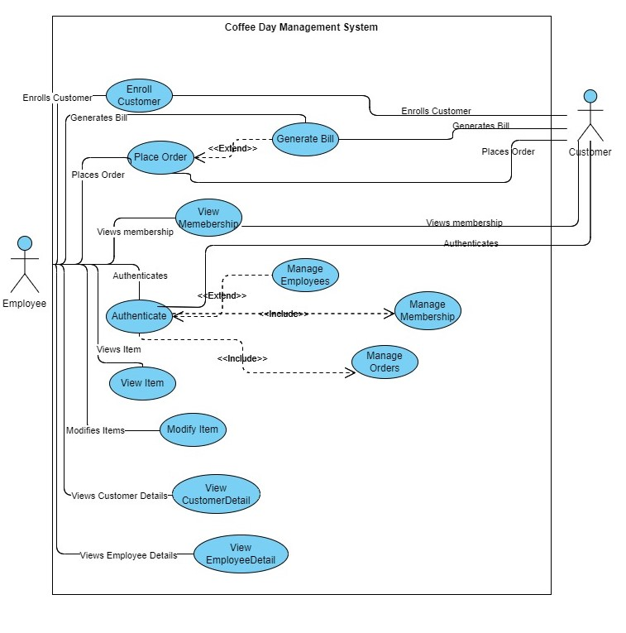
USE CASE DIAGRAM

Slide 8
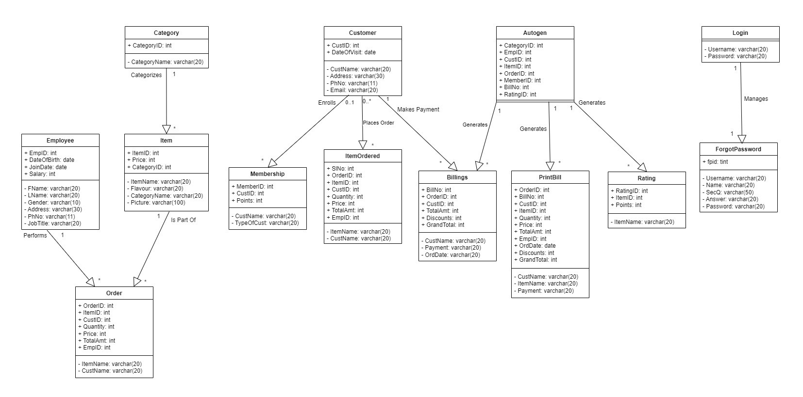
UML CLASS DIAGRAM

Slide 9
CONCLUSION
In conclusion, the Coffee Day Management System simplifies how coffee shops manage their records. Instead of using heavy ledgers for customer, employee, order, and billing details, the project introduces a user-friendly system. This change not only reduces errors but also makes the overall process much easier. It allows coffee shop owners and staff to focus more on providing great customer service rather than spending time on manual paperwork. The project demonstrates how technology can make running a coffee shop more organized and efficient, adapting to the industry's evolving needs.

Slide 10

Thank you ☺
COFFEE DAY MANAGEMENT SYSTEM

